Slide 1
CATEGORY A
Carlos Albán Holguín i.e.d

Slide 2
Aleatorios
https://wordwall.net/es/resource/29039457 Ronda 1 y 2
https://wordwall.net/es/resource/29039675 Ronda 3 y 4
https://wordwall.net/es/resource/29039915 Ronda 5
https://wordwall.net/es/resource/29040744 Ronda 6
https://wordwall.net/es/resource/29040026 Ronda 7

Slide 3
Keep in mind….
Capital letter
Space
Apostrophe
Dash/hyphen
Exclamation mark
Question mark
M B R Y D G V B
milk carton
‘ I’d love to
life-style
Good morning!
How often?

Slide 4
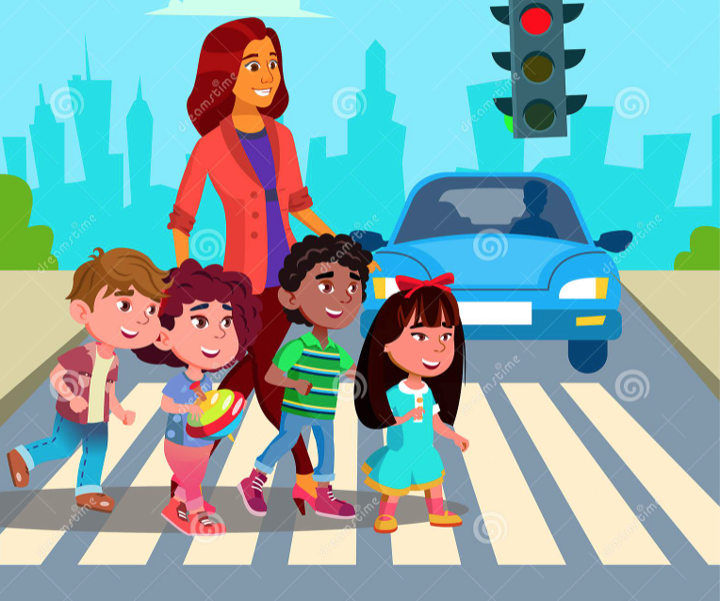

across

Slide 5
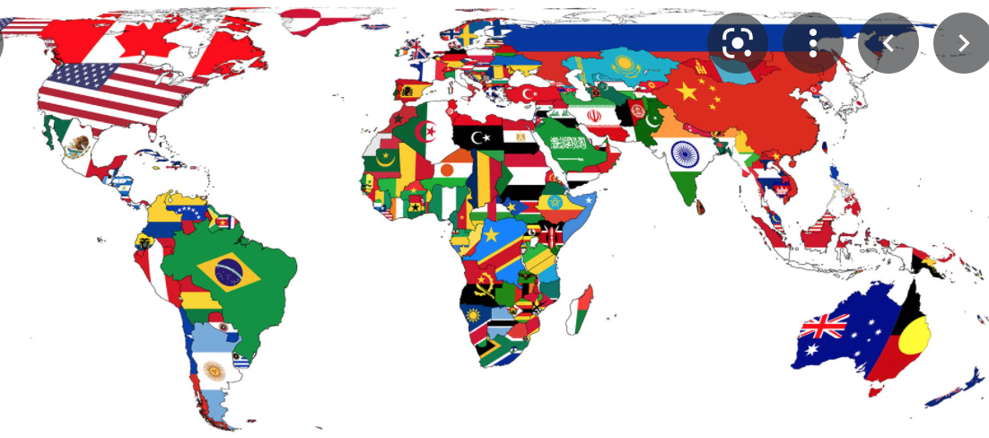
country

Slide 6
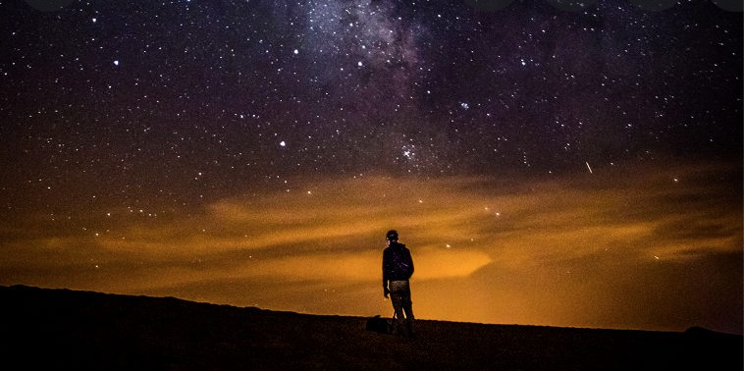
evening

Slide 7
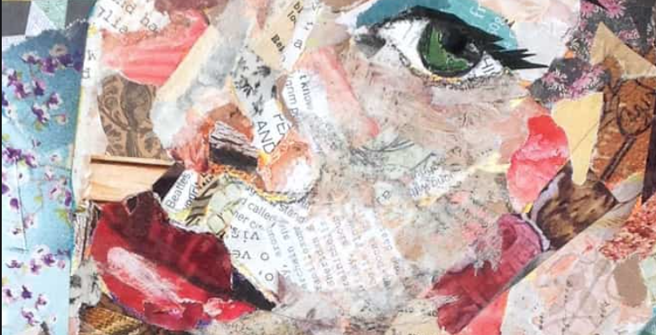
collage

Slide 8
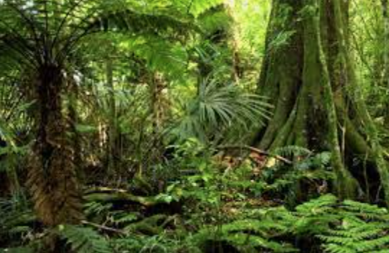
jungle

Slide 9
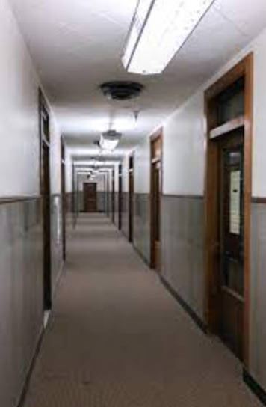
hallway

Slide 10
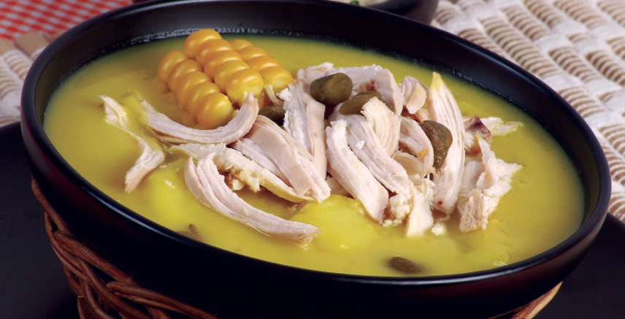
typical

Slide 11
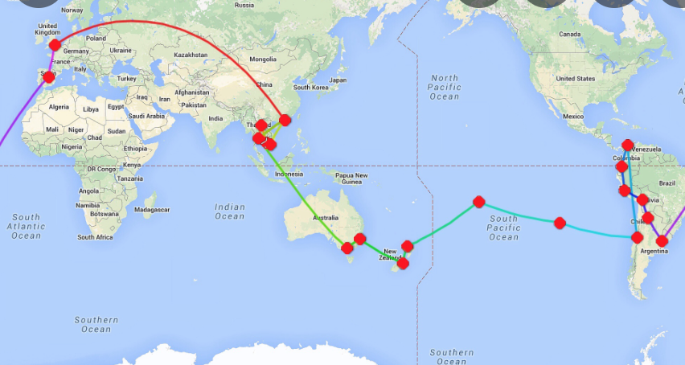
journey

Slide 12
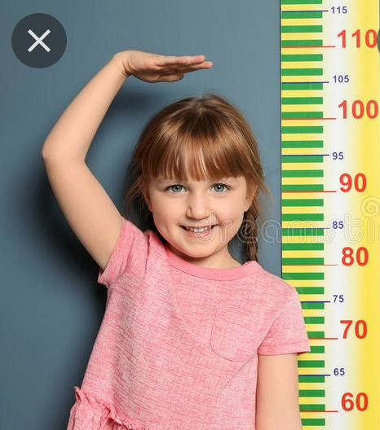
height

Slide 13
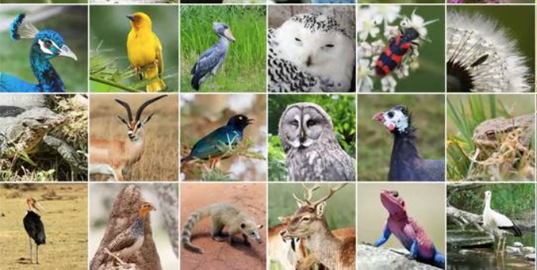
species

Slide 14
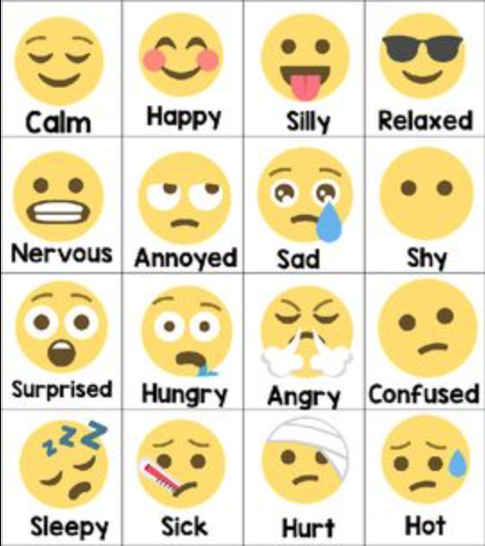
feeling

Slide 15
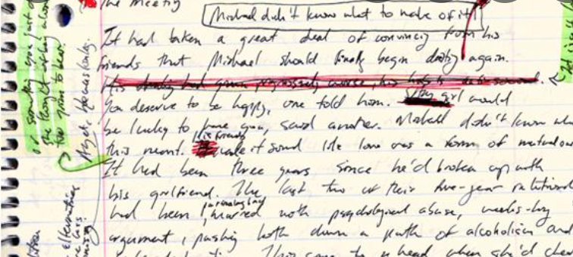
rewrite

Slide 16
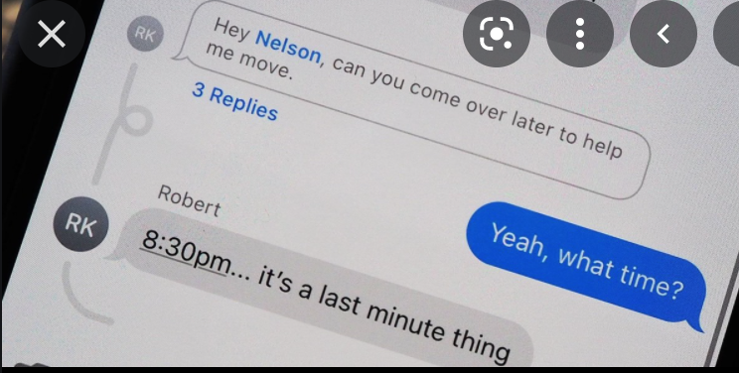
replies

Slide 17
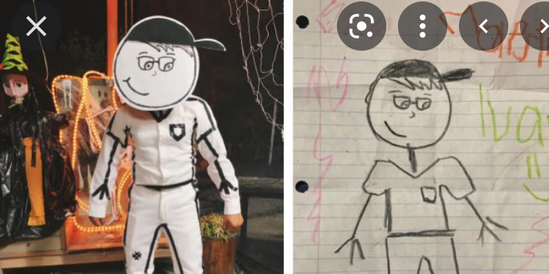
another

Slide 18
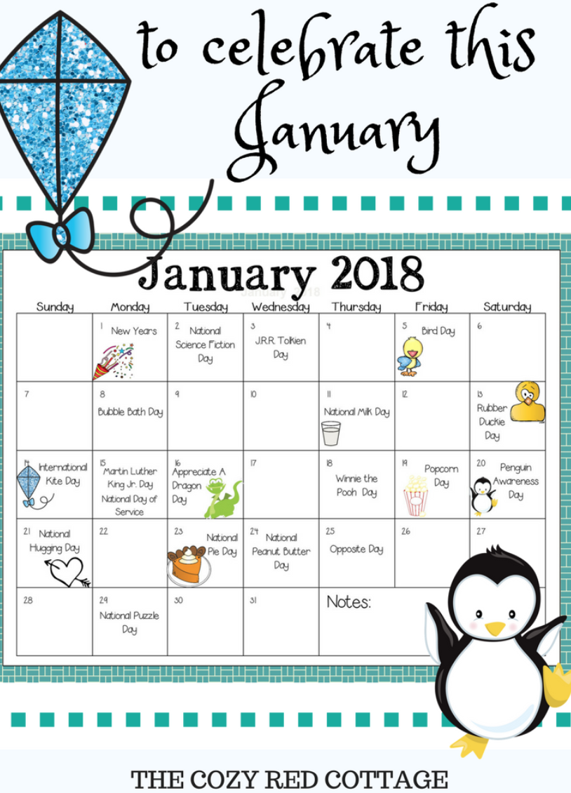
January

Slide 19
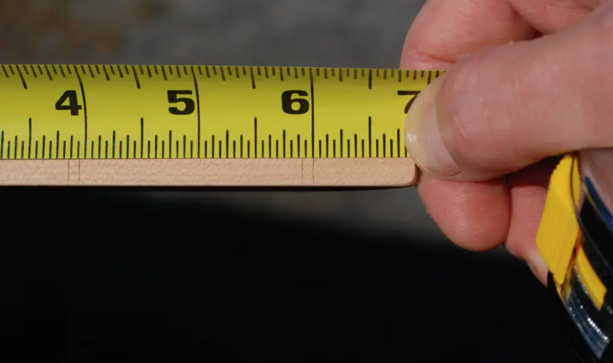
measure

Slide 20
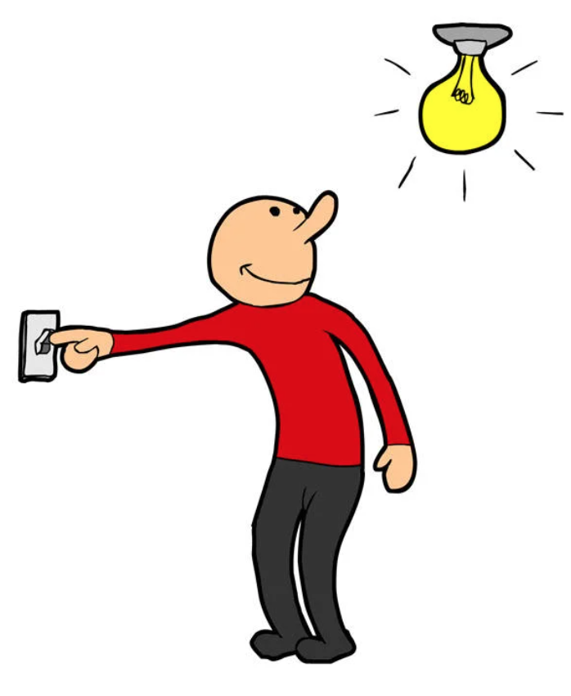
Turn on

Slide 21
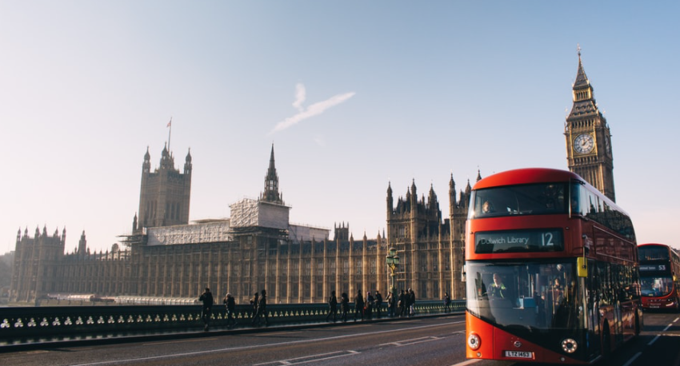
England

Slide 22
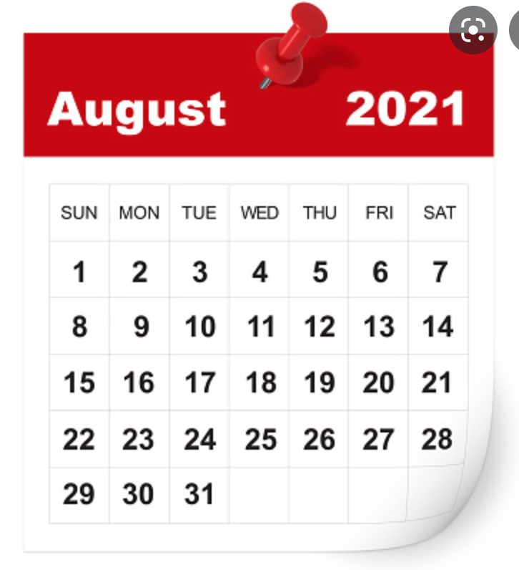
August

Slide 23
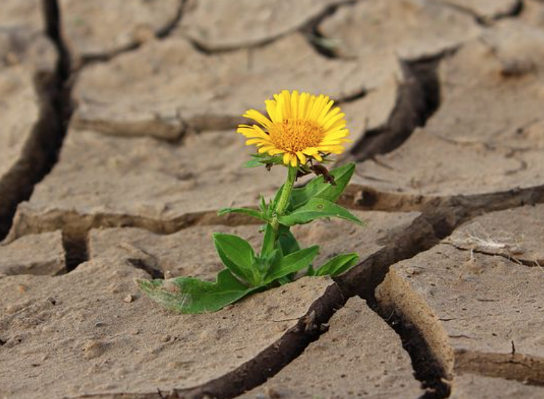
survive

Slide 24
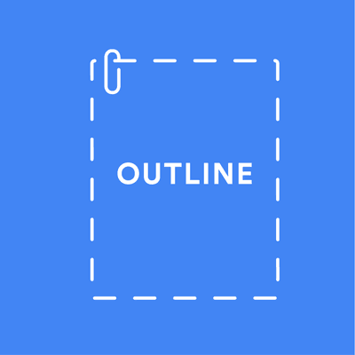

outline

Slide 25
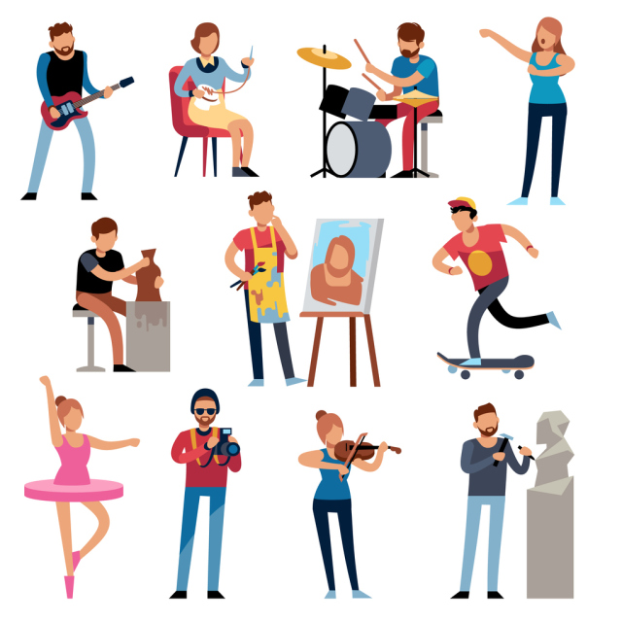
hobbies

Slide 26
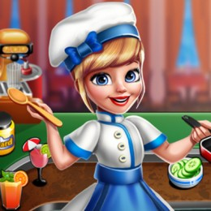
cooking

Slide 27

discuss

Slide 28

square

Slide 29
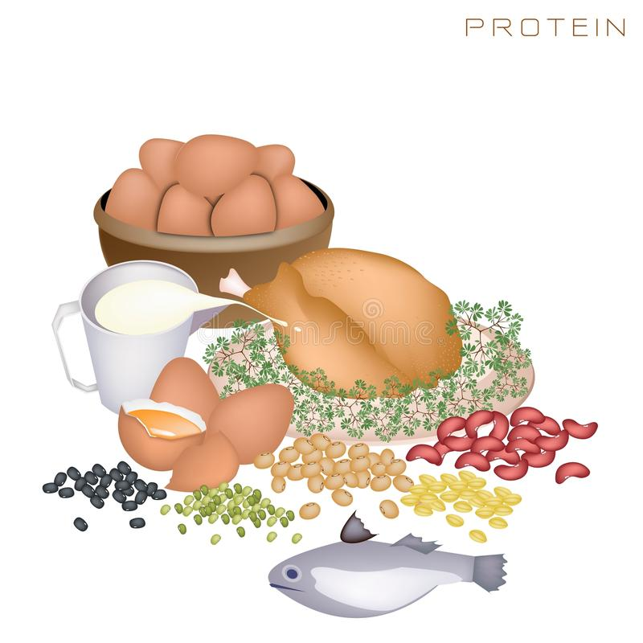
protein

Slide 30
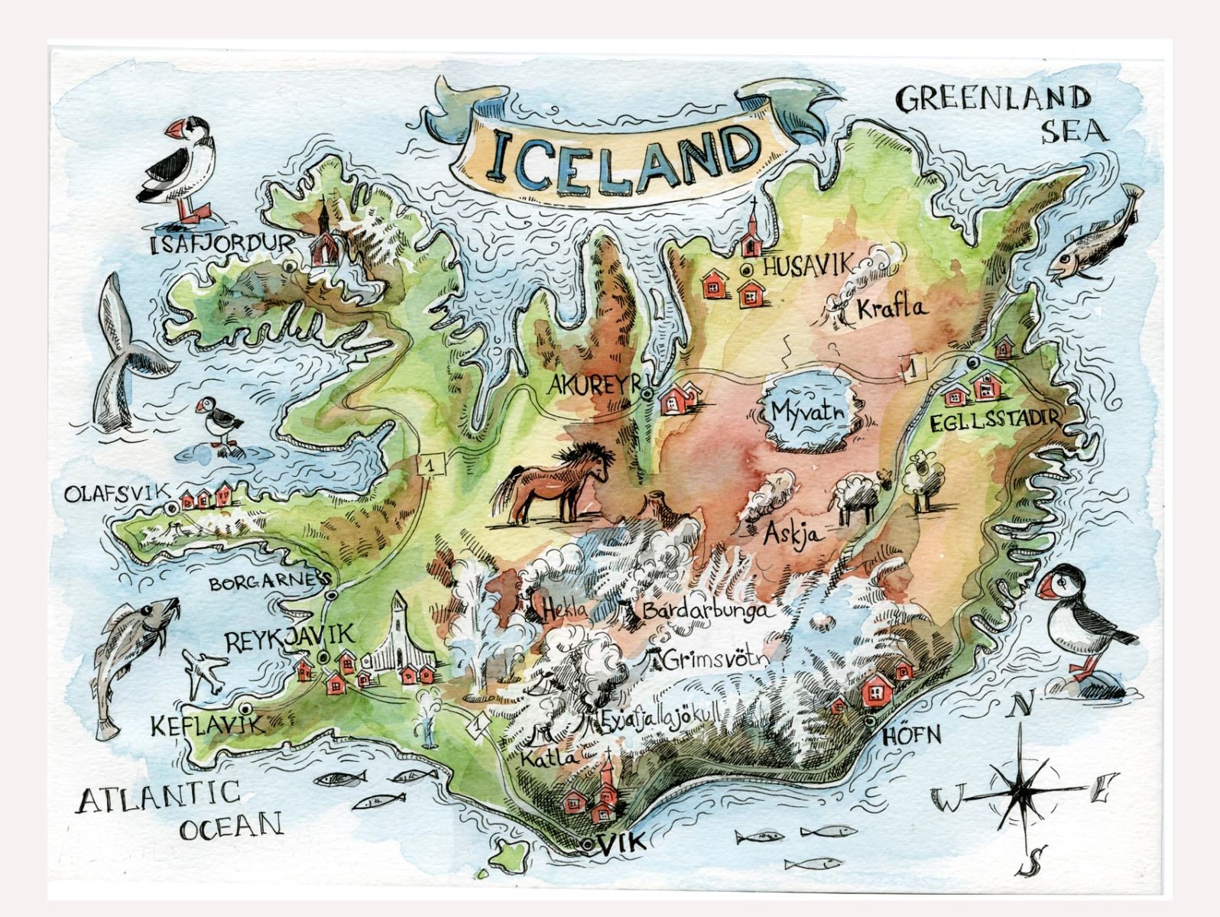
Iceland

Slide 31

issues

Slide 32

mountain

Slide 33
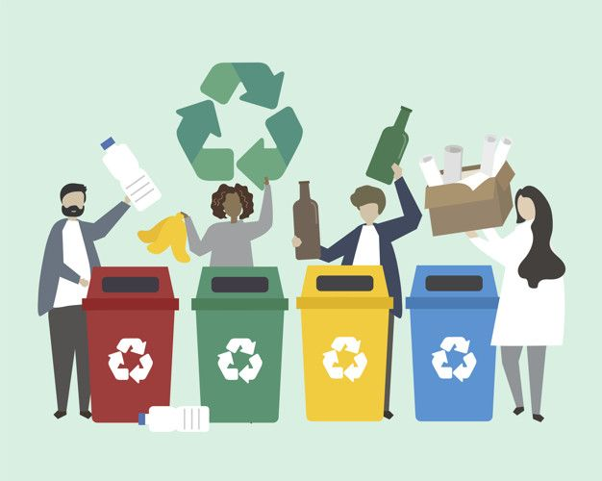
recycle

Slide 34
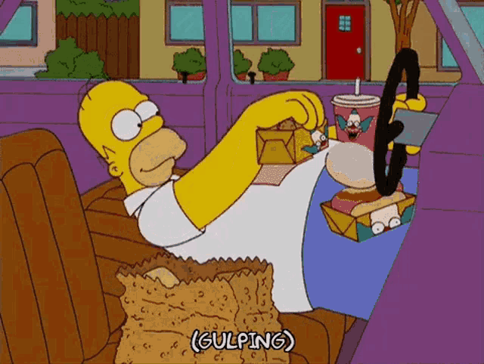
physical
I'm not a very physical sort of person

Slide 35
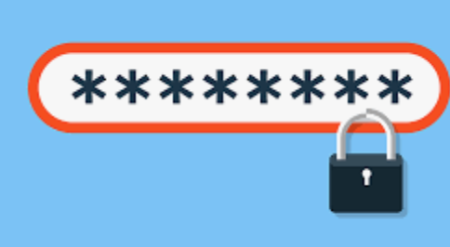
password

Slide 36

teamwork

Slide 37

assertive

Slide 38
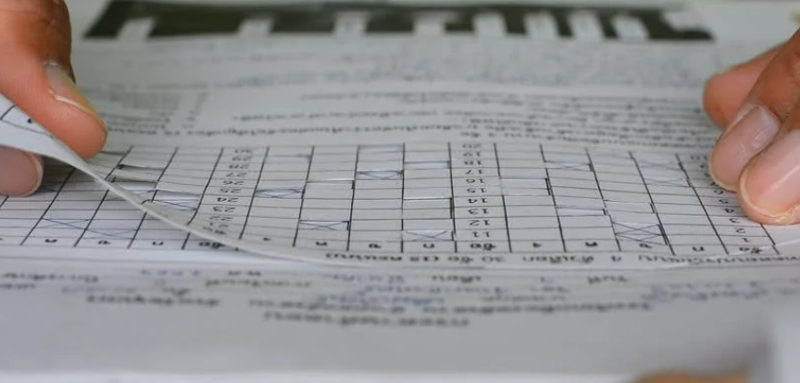
cheking
After I'd finished the exam, I checked my answers for mistakes

Slide 39

How often?

Slide 40
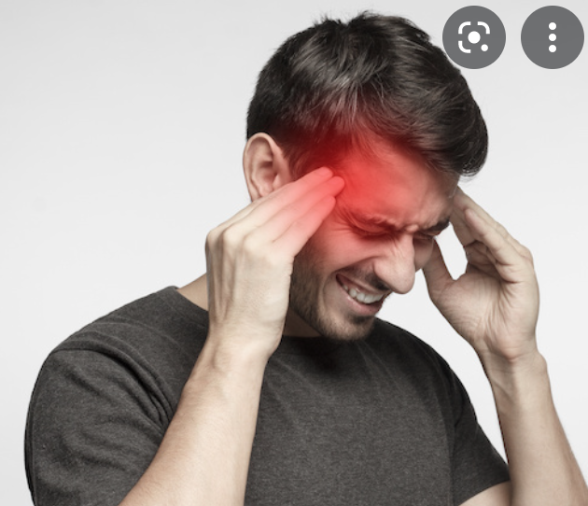
headache

Slide 41

magazine

Slide 42

diagrams

Slide 43

keep calm

Slide 44
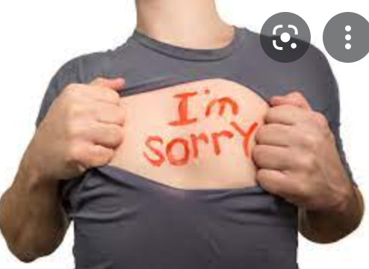
apologize

Slide 45

I’m first

Slide 46
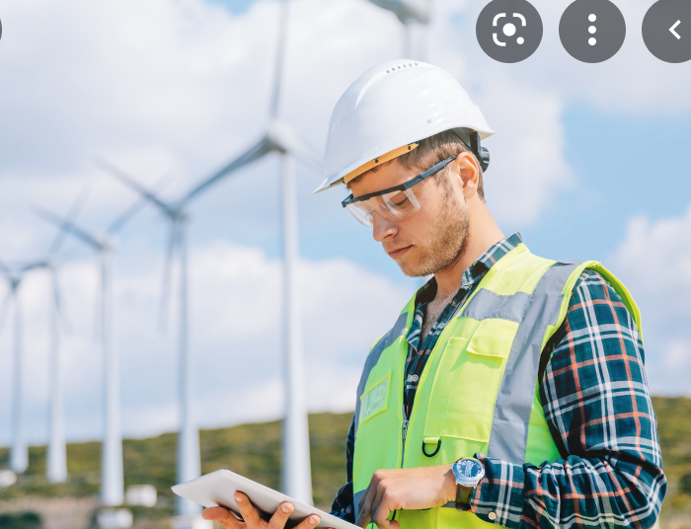
enginner

Slide 47
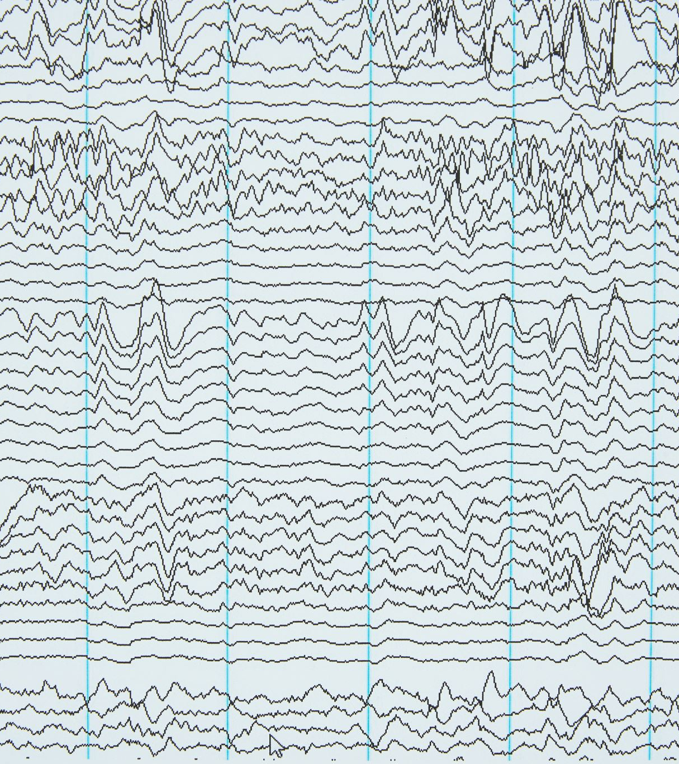
frequency

Slide 48
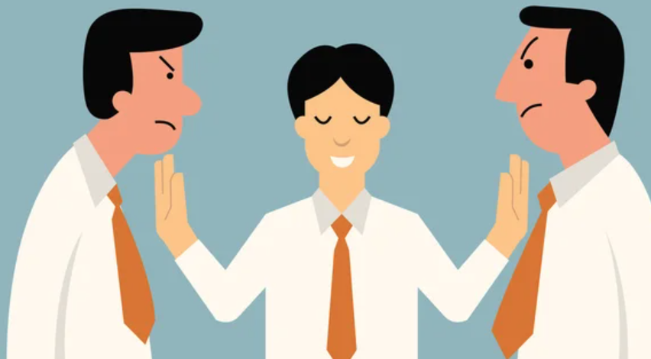
mediate

Slide 49
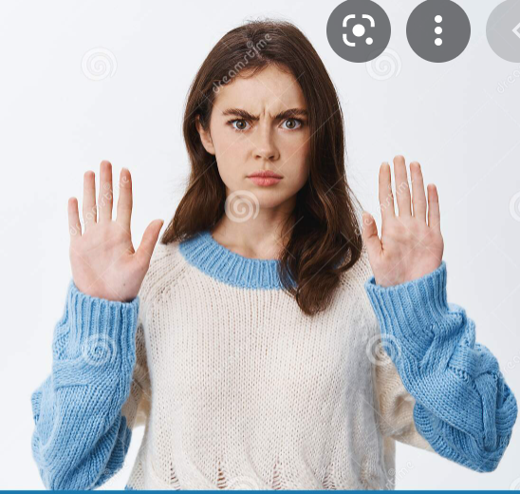
shouldn’t
You really shouldn't criticize him

Slide 50
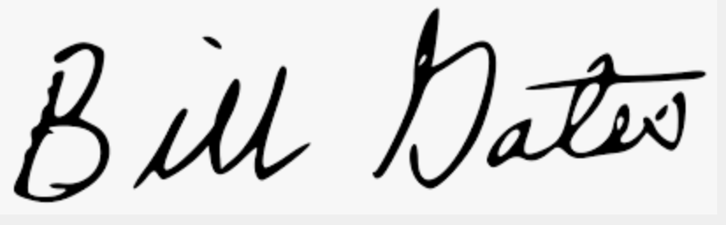
signature

Slide 51
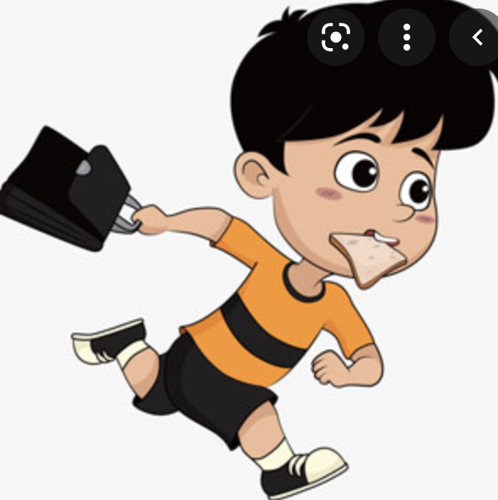
Hurry up!

Slide 52

straight

Slide 53
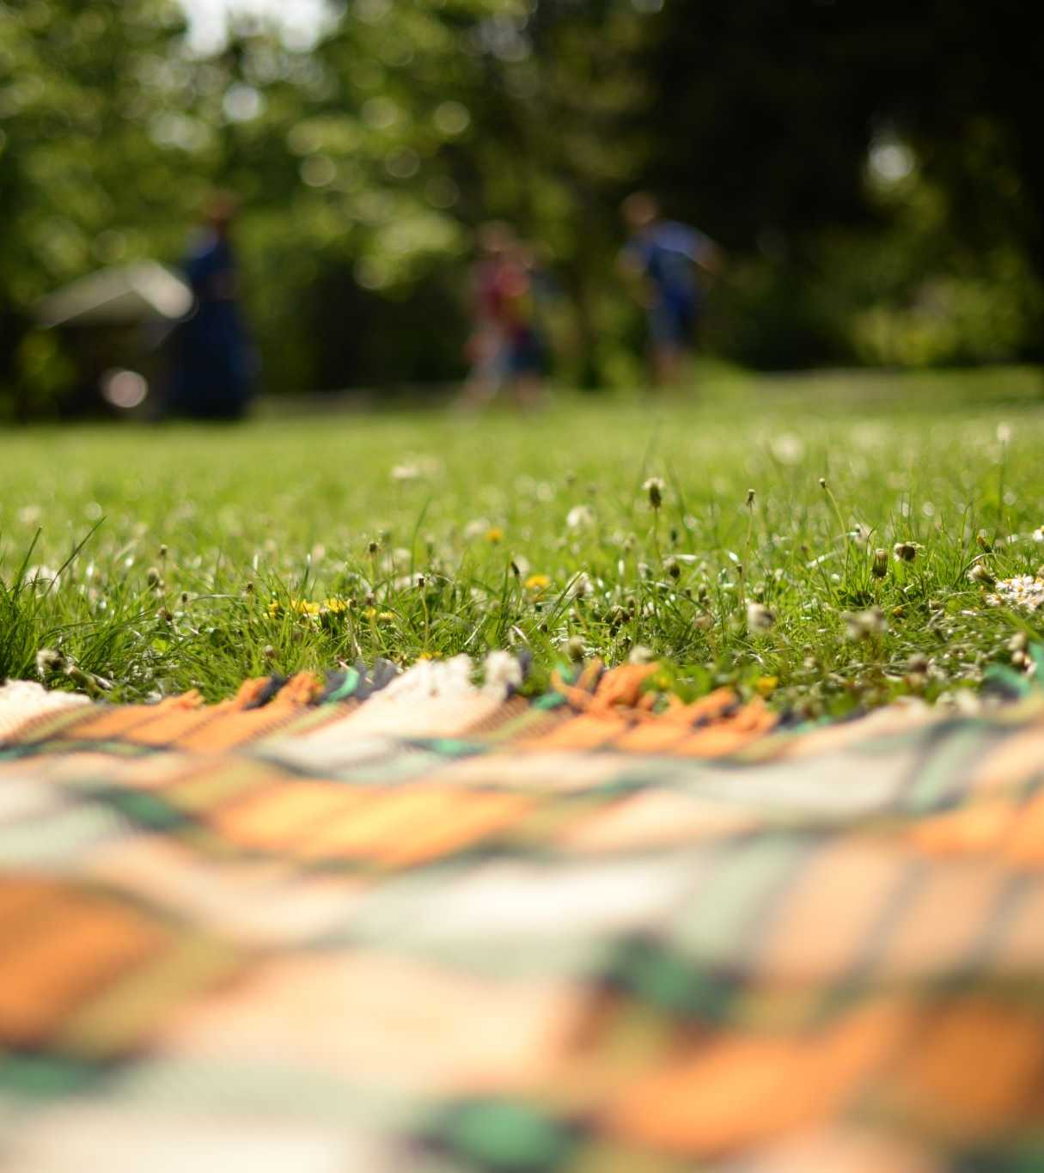
outdoors

Slide 54
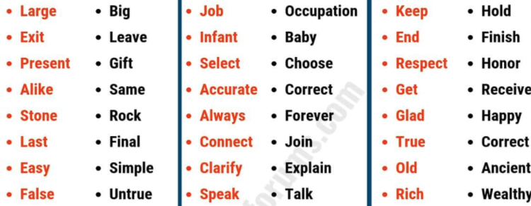
synomyms

Slide 55

worldwide

Slide 56
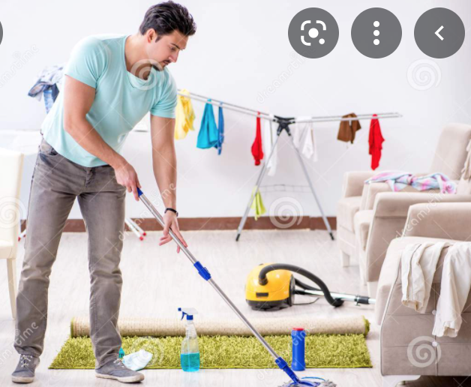
cleaning

Slide 57
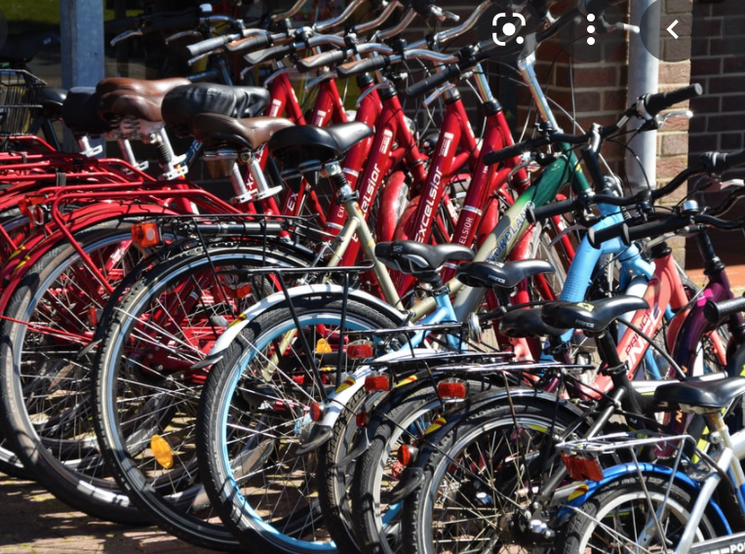
bicycles

Slide 58
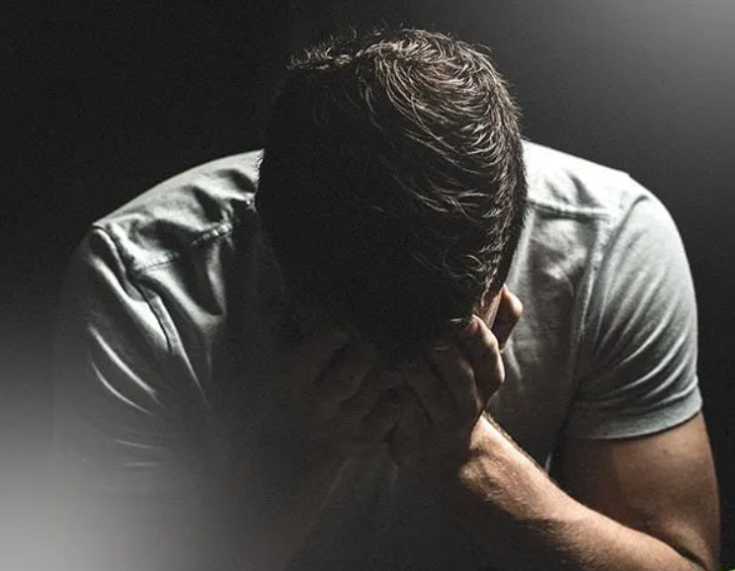
I’m sorry

Slide 59
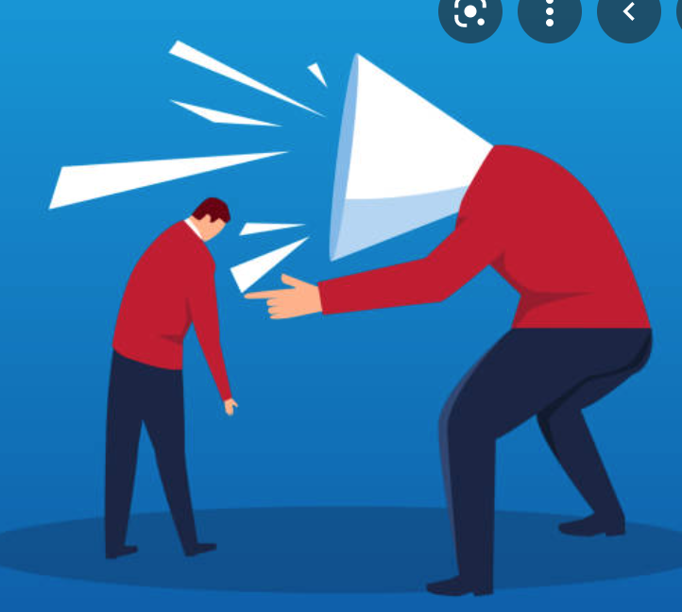
criticism

Slide 60
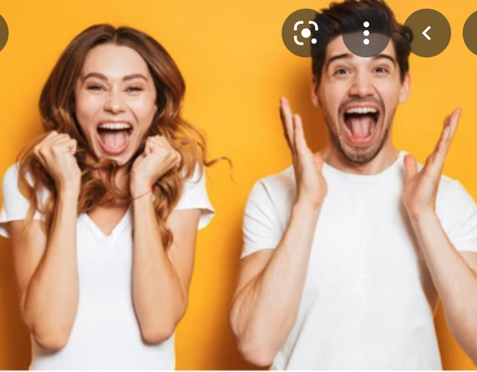
delighted

Slide 61
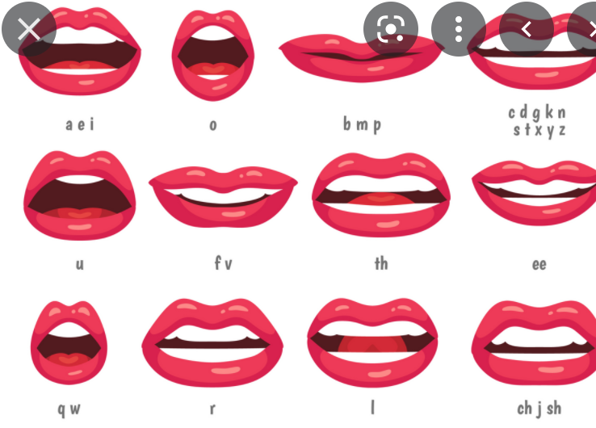
pronounce

Slide 62
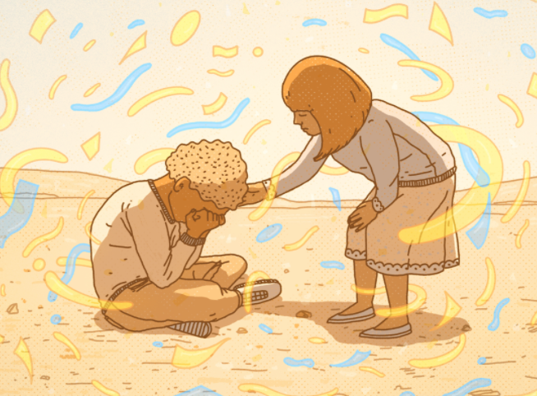
kindness

